Slide 1
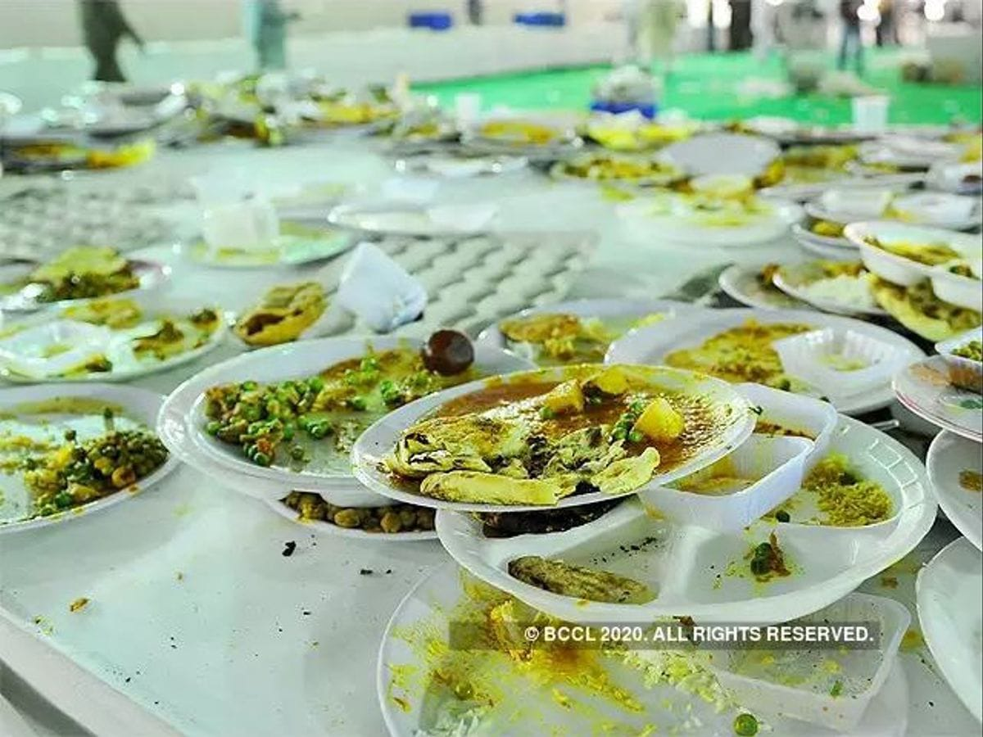
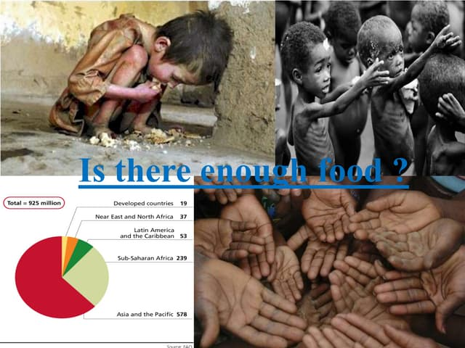
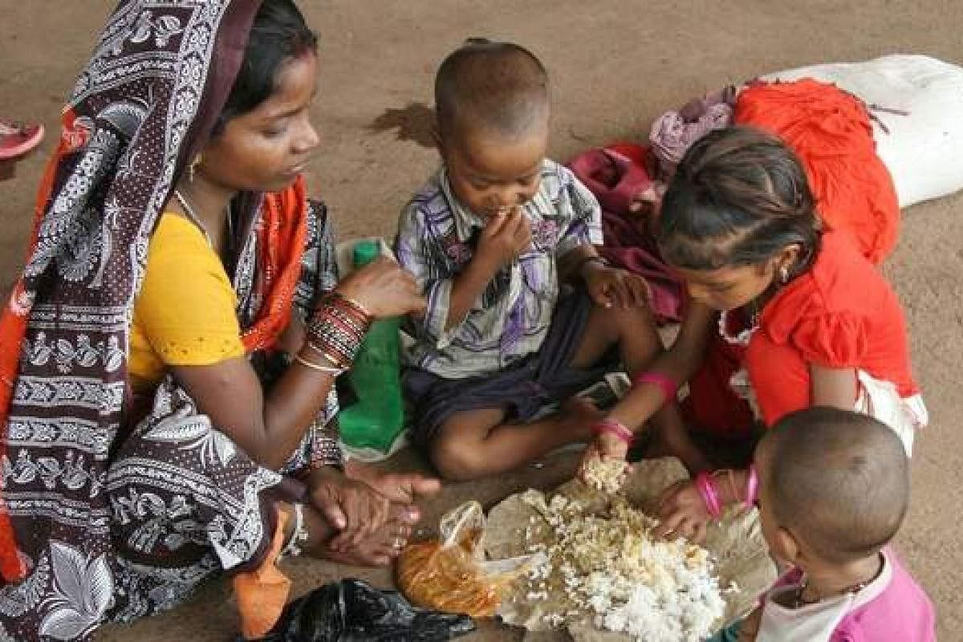
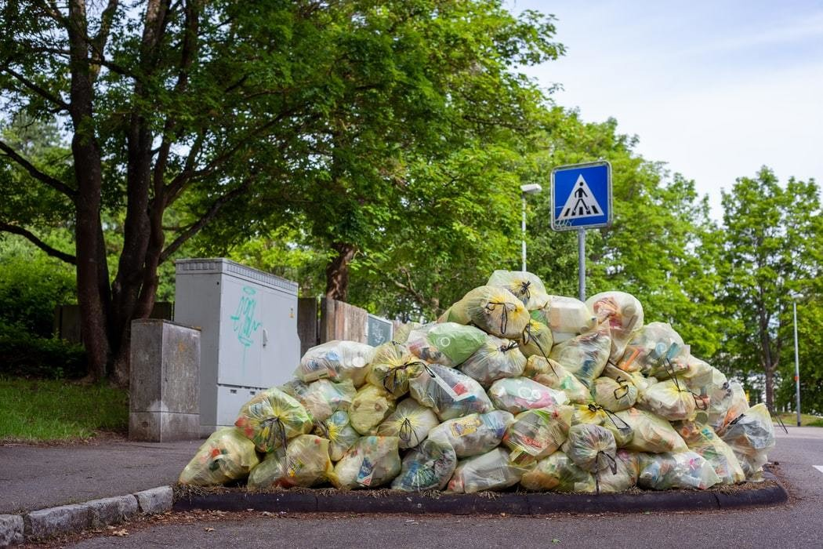

Slide 2
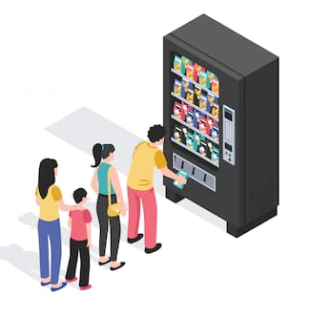


FEED THE NEEDY,NOT THE GREEDY!!!
SMART FOOD
DONATOR
INTEGRATED WITH HUNGERHERO APP
COMBATING FOOD WASTE AND HUNGER THROUGH TECHNOLOGY

Slide 3
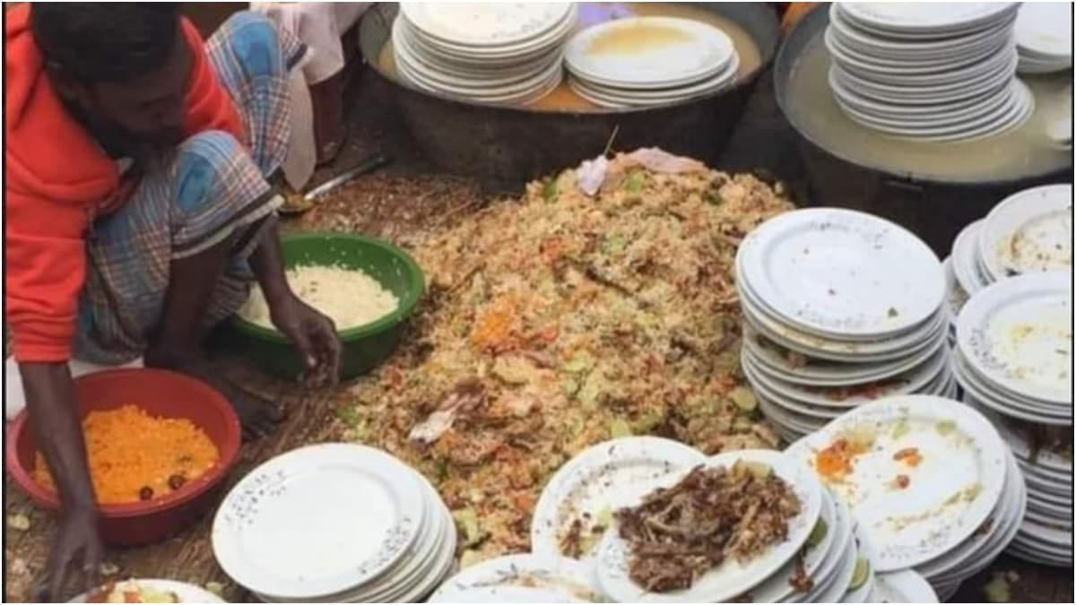
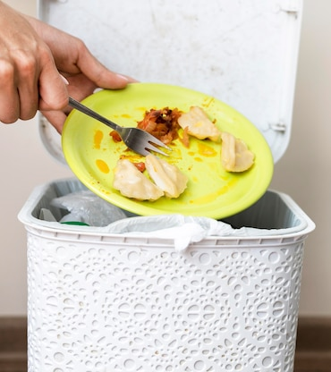
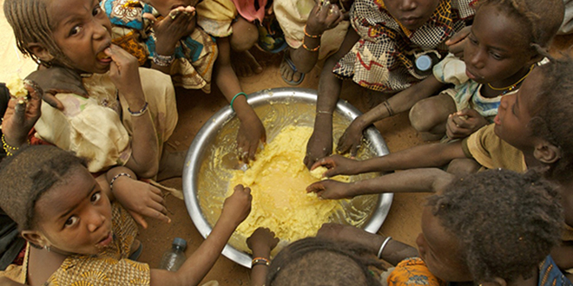
ABSTRACT
Food waste and hunger are major global issues that continue to plague society. According to the United Nations, over one-third of the world's food is being wasted, while millions of people suffer from hunger, including India, where food waste is estimated to be around 67 million tonnes annually. Current methods to reduce food waste and combat hunger are often inefficient, require a large workforce, and have limited storage capacity. To address these challenges, we have developed the Smart Food Donator Machine integrated with the HungerHero app. Our innovative solution provides an easy and efficient way for individuals and organizations to donate excess food items, which are automatically sorted, packaged, and stored in the machine. The HungerHero app enables users to locate the nearest machine and donate surplus food, while charitable organizations and food banks can access the inventory and collect the donated food items.
In this presentation, we will discuss the limitations of existing methods for reducing food waste and how the proposed method overcomes those limitations.

Slide 4
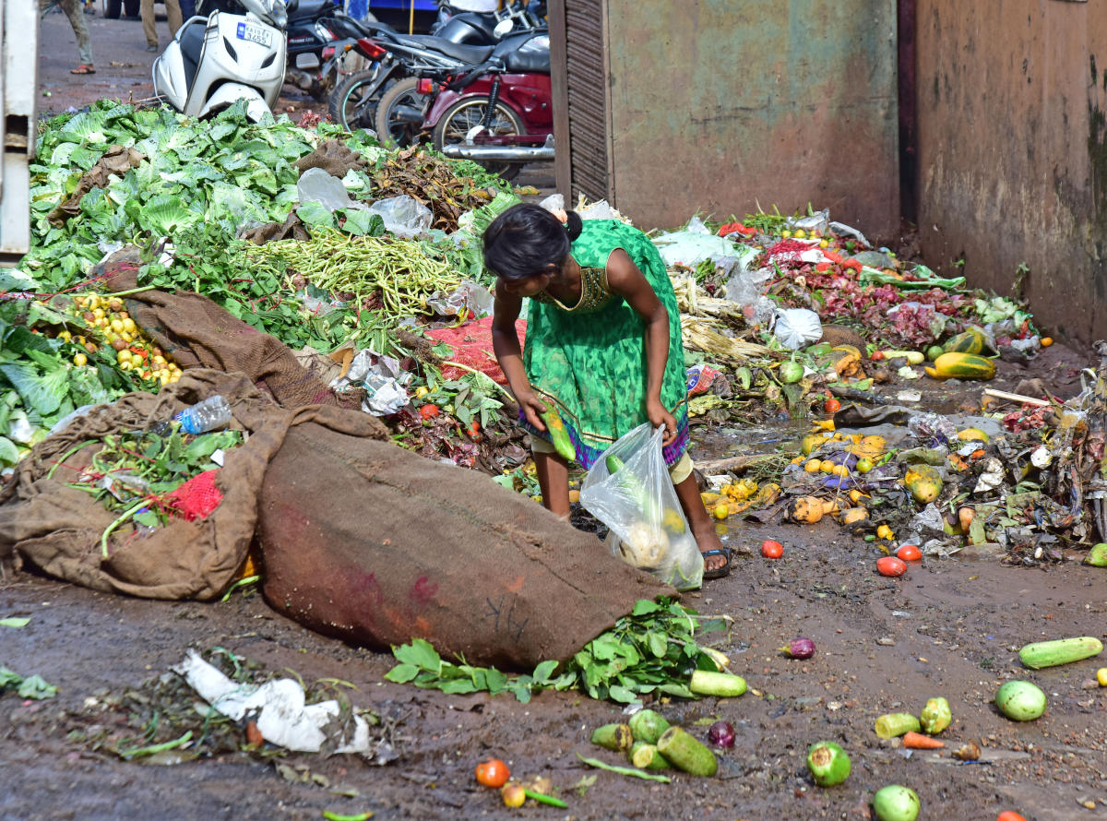
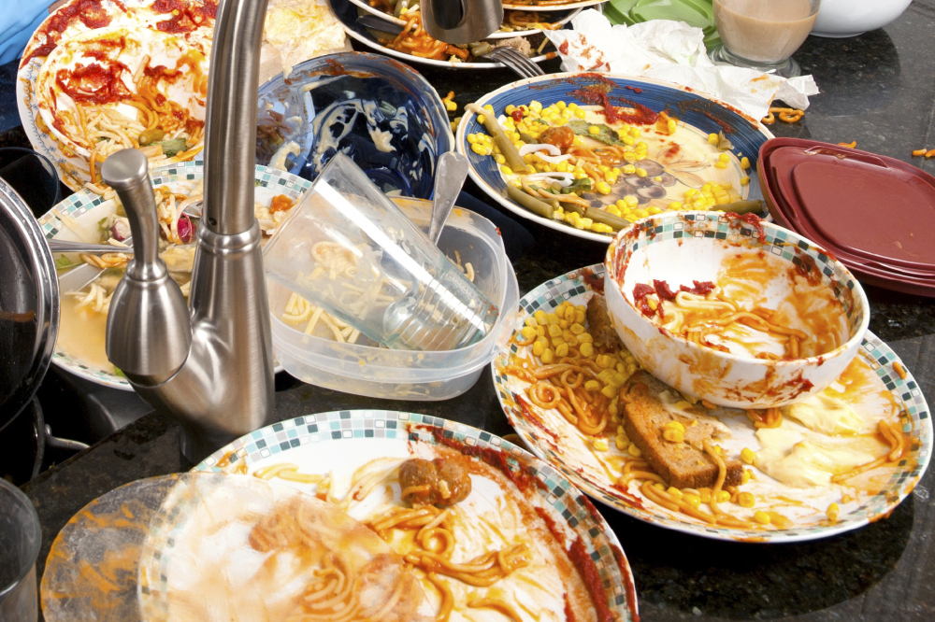
EXISTING METHODS AND ITS LIMITATIONS
There are several existing methods for reducing food waste, including food banks, food pantries, and food rescue programs. However, these methods have certain limitations, such as:
Limited access: Food banks and pantries are not available in all areas, and food rescue programs are not always able to reach all sources of excess food.
Time-consuming: These methods involve manual sorting, packaging, and distribution of food, which can be time-consuming and require a large workforce.
Limited storage: Food banks and pantries have limited storage capacity, which can lead to food waste if the donated food exceeds their capacity.

Slide 5
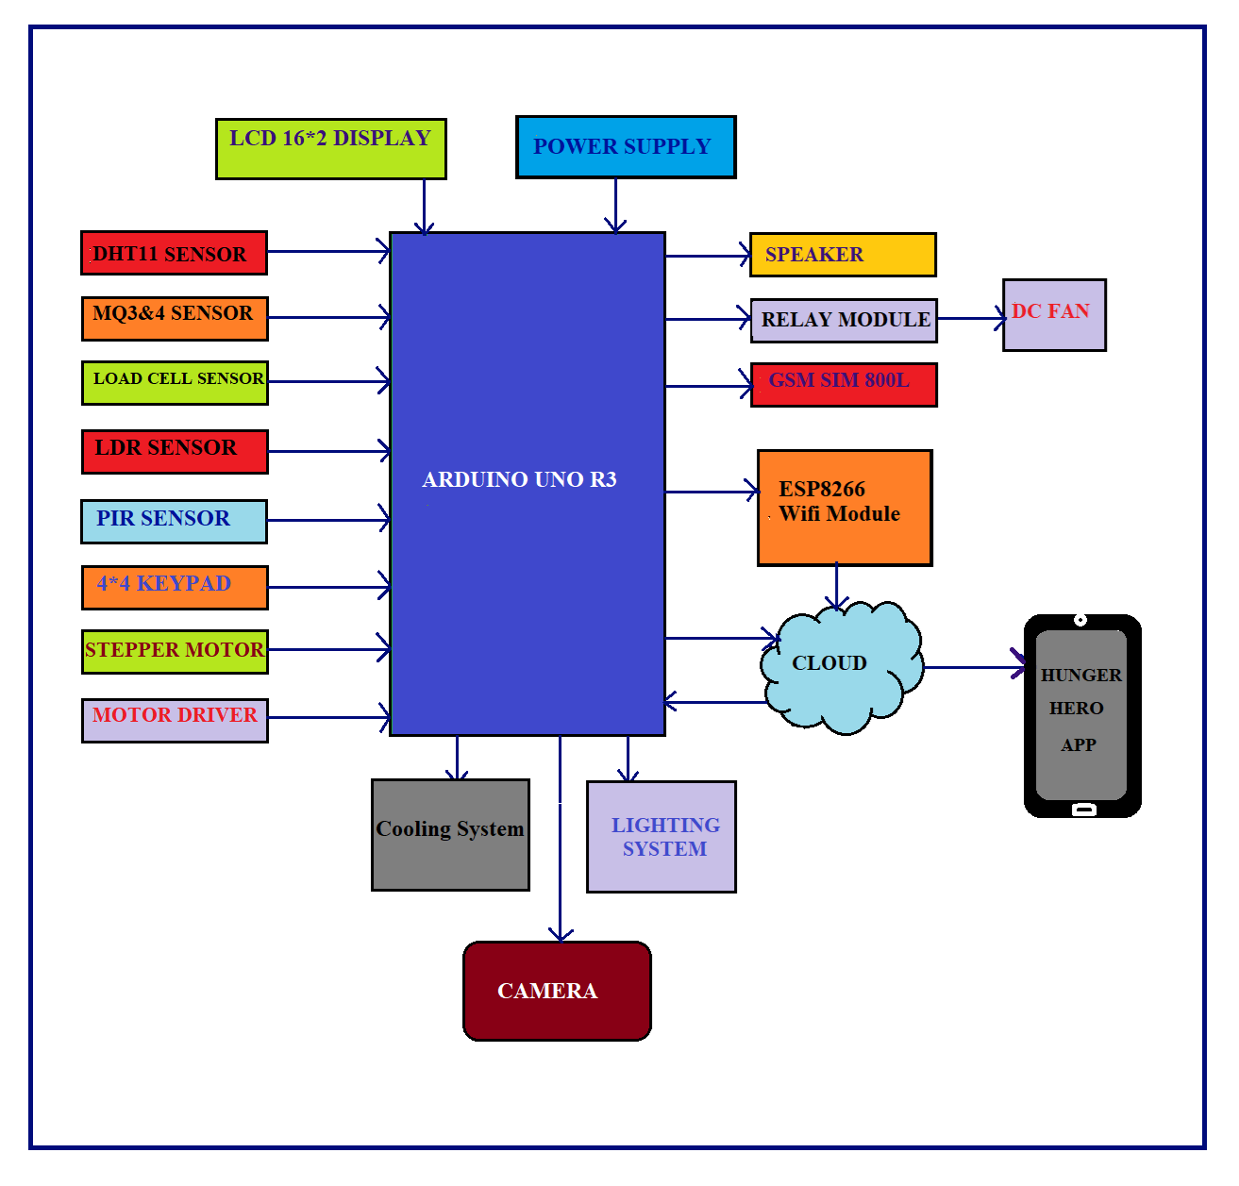
PROPOSED METHOD
Our proposed solution is the Smart Food Donator Vending Machine integrated with the HungerHero app, which overcomes the limitations of existing methods. Here's how it works:
Users can download the HungerHero app and create a profile.
They can then use the app to locate the nearest Smart Food Donator Vending Machine.
Users can scan the QR code on the vending machine and donate their excess food items.
The machine uses sensors and cameras to check the quality and freshness of the donated food.
The machine then stores the donated food in the appropriate compartments, which are temperature-controlled to maintain the freshness of the food.
Charitable organizations and food banks can access the vending machine's inventory and collect the donated food.
BLOCK DIAGRAM
Ex

Slide 6
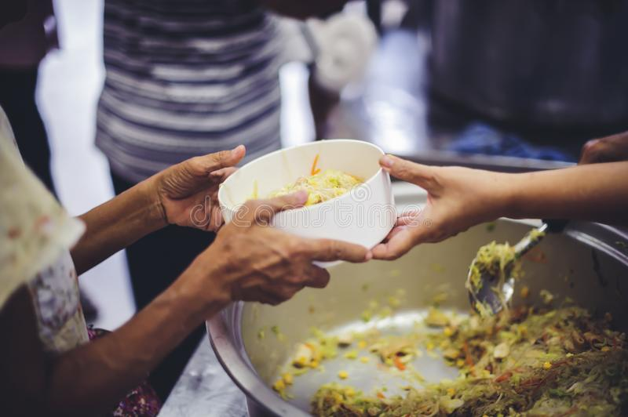
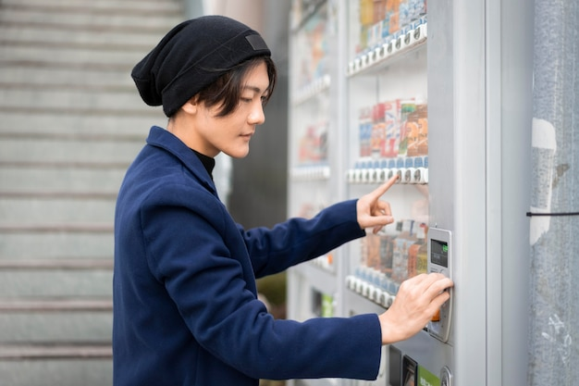
MERITS
The Smart Food Donator Vending Machine integrated with the HungerHero app has several merits:
Easy access: The vending machine is available 24/7 and can be located in areas where food banks and pantries are not available.
Quick and efficient: The machine can automatically sort, package, and store the donated food items, which saves time and reduces the need for manual labor.
Increased storage capacity: The machine has a larger storage capacity than food banks and pantries, which reduces the risk of food waste.

Slide 7
MAJOR HARDWARE &SOFTWARE USED
HARDWARE USED
SOFTWARE USED
Arduino UNO R3,
NodeMCU ESP8266,
Sensors include gas sensor MQ5,4,3,IR Sensor.
Camera,
temperature controllers,
power supply,
connectivity modules.
Arduino IDE Software,
Thingspeak web app,
HungerHero app,
Flutter & Firebase backend
inventory management system and machine learning algorithms for food quality and freshness checks.

Slide 8
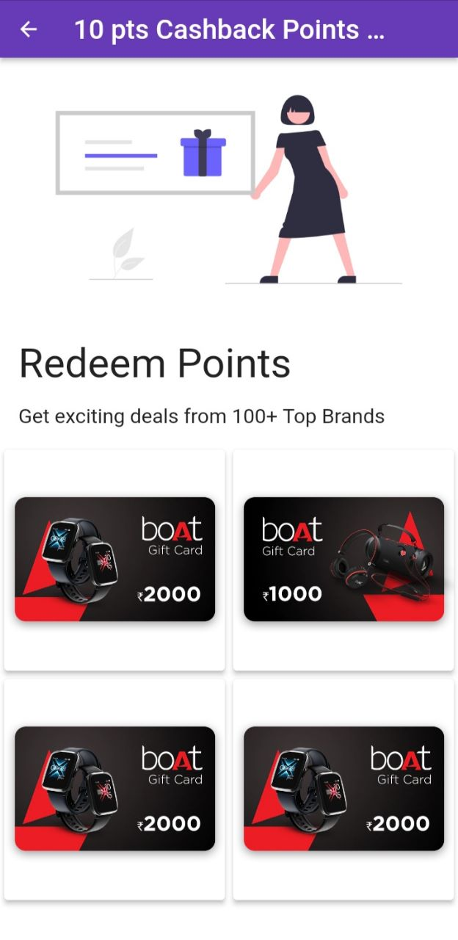
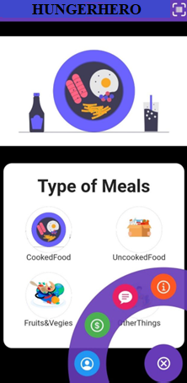
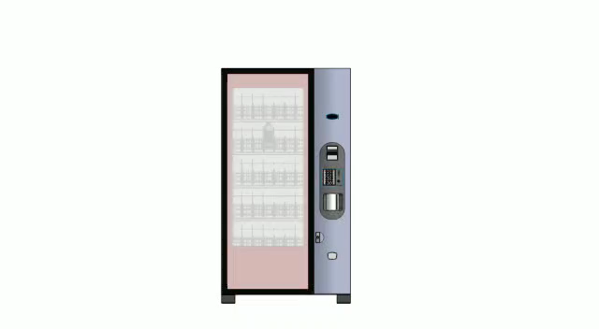
WORKING DEMO
HUNGERHERO
INTEGRATED WITH APP
SMART FOOD DOANTOR MACHINE LIKE VENDING MACHINE DESIGN

Slide 9
Cost Estimation
TOATL COST

Slide 10
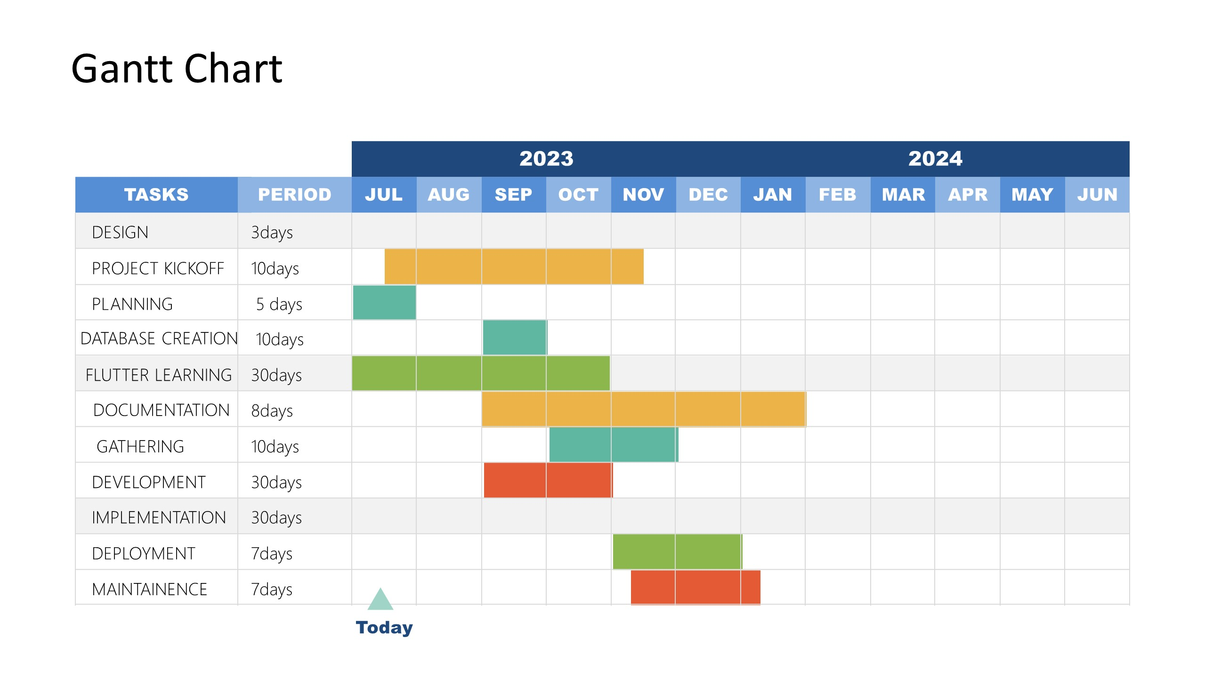
Work Schedule
WORKING DETAILS

Slide 11
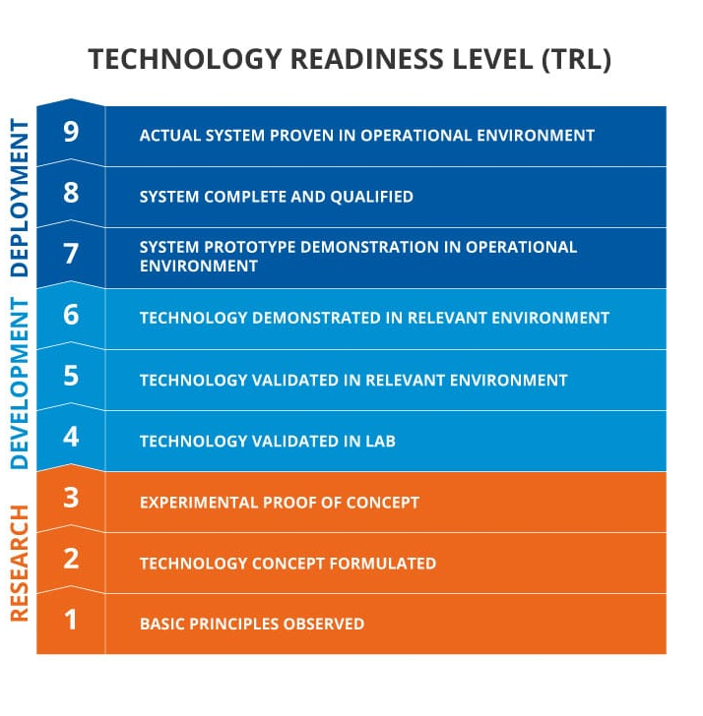
TRL LEVEL
(Technology Readiness level)
TRL stands for Technology Readiness Level, and it is a measure used to assess the maturity of a technology or product. TRL levels range from 1 to 9, with level 1 indicating basic research, and level 9 indicating commercial deployment.
The TRL level of Smart Food Donator project is at stage 3, indicating that a working prototype has been built and the design is being developed further. Testing and validation of the prototype are likely to be the next steps to reach a higher TRL level..

Slide 12
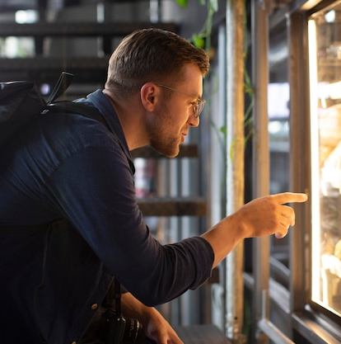
REFERENCES &LITERATURE SURVEYS
Here are some of the references we used to devlop the Smart Food Donator Vending Machine integrated with the HungerHero app:
Ahaar App food donation based app(Northern side of India)
Seva App (Northern side of India)
"Food Waste and Loss Facts." World Wildlife Fund, 2021.
"Food Donation Guidelines." Feeding America, 2021.
"Hunger and Poverty Facts and Statistics." World Food Program, 2021.
"The Global Food Waste Scandal." The Guardian, 2018.
Feeding America. (2021). Hunger in America: In-depth. https://www.feedingamerica.org/hunger-in-america/in-depth - Gunders, D. (2017). Wasted: How America Is Losing Up to 40 Percent of Its Food from Farm to Fork to Landfill. University of California Press.
HungerHero. (2021). About Us. https://www.hungerhero.org/about-us
USDA. (2021).
Food Loss and Waste. https://www.usda.gov/foodlossandwaste

Slide 13
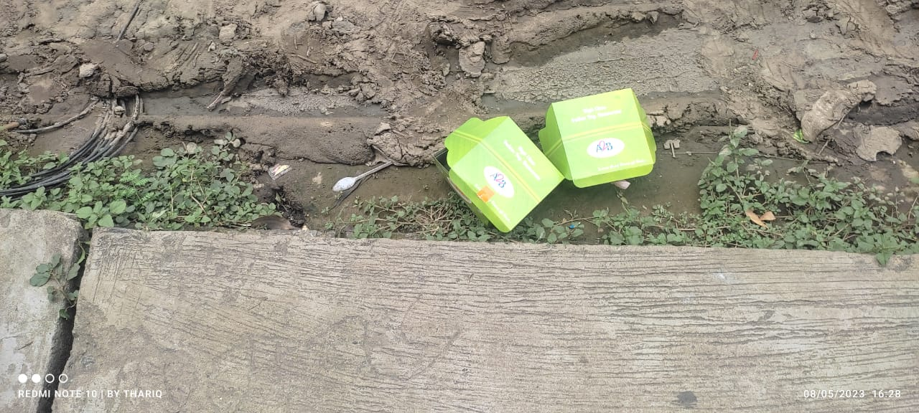
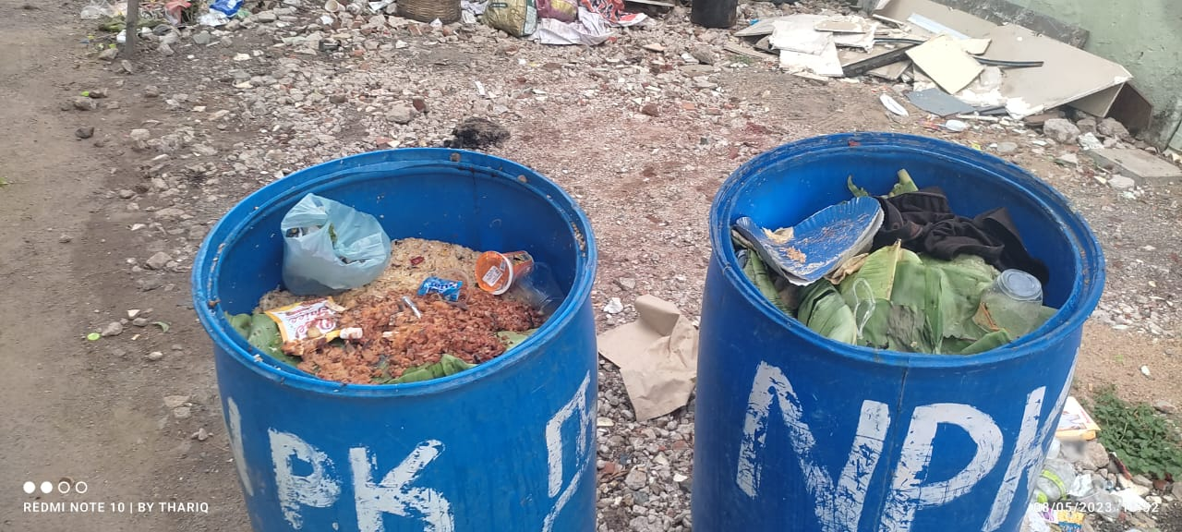
THANK YOU
Any Questions ?
Yesterday At Mahal side,Periyar side sweets boxes with sweets are thrown away
Public places like Vishaal De Mall
Container by container food waste

